Slide 1
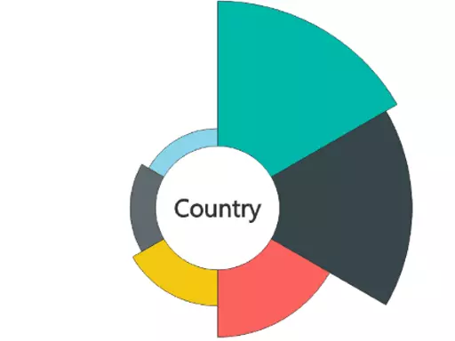
Individual Custom Visualizations Types
1. Aster Plot
Aster plot charts are similar to pie charts and doughnut charts. In the aster plot, you can be able to visualize up to two measures.

Slide 2
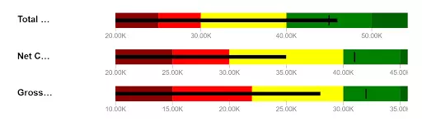
2. Bullet Charts
Bullet charts are the replacement of dashboard gauges and meters. They are useful to compare one or more measures to enrich the data.

Slide 3
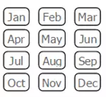
3. Chiclet Slicer
Chiclet Slicer is similar to the slicer and it is made of buttons.

Slide 4
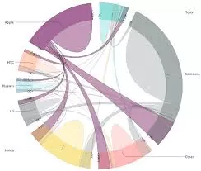
4. Chord
Chord diagram provides an easy way to identify the interrelationship data visualization in a matrix. A circular chart shows the relationship between the variables, and it connects the data points in the form of an arc in the chord chart.

Slide 5
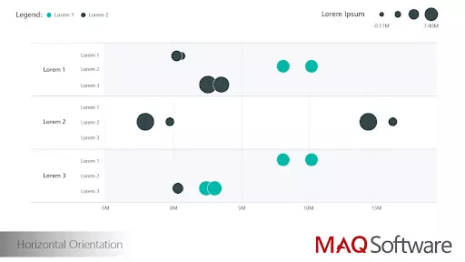
5. Dot plot
A dot plot chart is similar to the scatter chart and bubble chart, and it allows you to compare multiple measures by their magnitudes and represent the data with the dot.

Slide 6
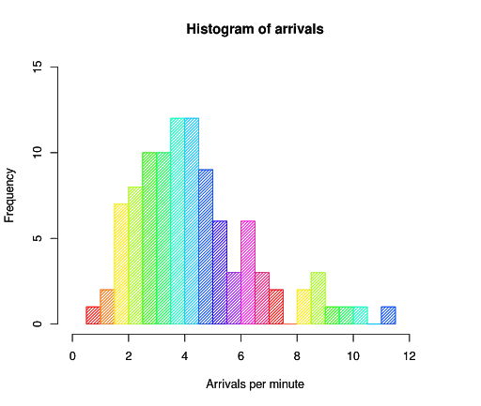
6. Histogram
A histogram chart is similar to a column chart, and it visualizes the distribution of data over a certain time.

Slide 7
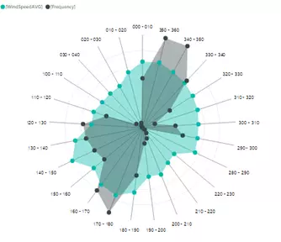
7. Radar Chart
A radar chart is a graphical chart to display various types of data in the form of two-dimensional charts. It compares two or more variables to display on the axes starting from the point.

Slide 8
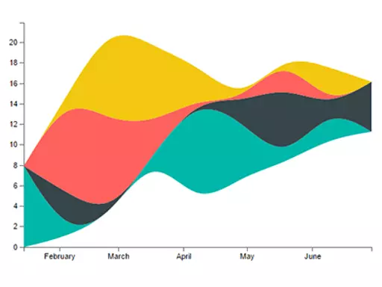
8. Stream Graph
A stream graph is a type of stacked graph which represents data around the central axis, it shows the changes in the data over a certain time through a flowing, organic shape that resembles a river-like stream.

Slide 9
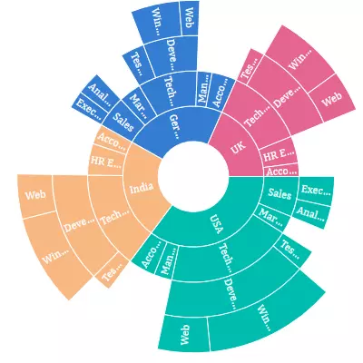
9. Sunburst
The sunburst chart is also called a multi-level pie chart, radial treemap, and ring chart which is used to visualize the typical hierarchical data.

Slide 10
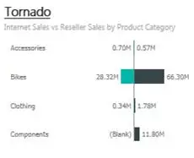
10. Tornado
Tornado charts are useful to analyze the sensor data compared to the relative variables.

